Slide 1
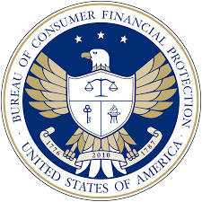
NIIT, Ikeja Study Center
Data Analytics- Project
Case Study: Consumer Financial Protection Bureau (CFPB).
Created by OJUMOLA JOSHUA
Date: 04th November 2025

Slide 2
Project Description and Deliverables
Description:
This project analyzes consumer financial complaints submitted to the Consumer Financial Protection Bureau (CFPB). The goal is to identify trends in complaints, product drivers, regional hotspots, company performance, and response timeliness to enhance transparency and consumer protection within the U.S. financial system.
Deliverables:
Cleaned and structured the complaint dataset (Excel format).
Interactive Power BI dashboard with visual insights.
Analytical summary addressing the case study questions.
Policy and industry recommendations for regulators and stakeholders.
Data Source:
Data were sourced from the CFPB’s public consumer complaint database, which contains detailed records on products, issues, companies, response types, and submission channels across U.S. states.

Slide 3
Project Objective
To uncover patterns and insights in consumer financial complaints, assess company response performance, and provide actionable findings that can support regulators, journalists, and consumers in improving financial fairness and accountability.
Data Overview
• Total records analyzed: 62,516 complaints.
• The dataset contains 62,516 rows and 19 columns in total.
• Key fields: product, sub-product, issue, company, state, date received, and response timeliness.
• Period covered: 2017–2023
Data Type: Multi-dimensional event dataset with temporal components.
Data Cleaning / Wrangling Processes
• Removed duplicates and irrelevant fields.
• Standardized product and issue categories.
• Converted date columns to consistent formats.
• Filtered missing or incomplete response data.
• Created calculated fields for response timeliness and complaint volume by period and product.

Slide 4
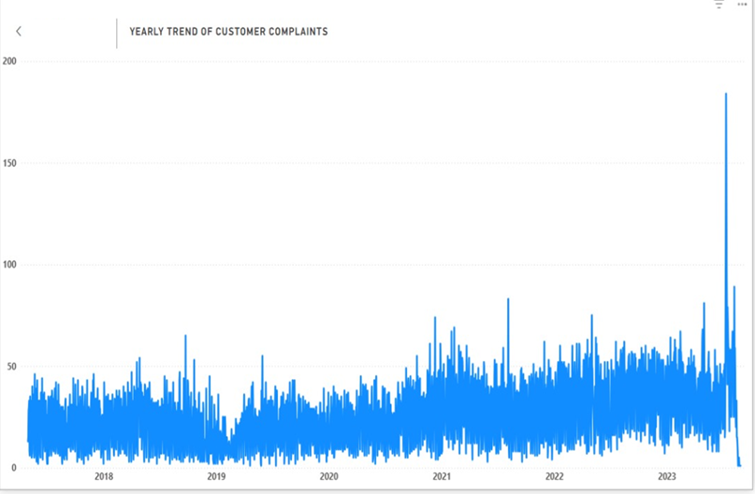
When do complaints rise or fall over time?
Yearly Trend of Customer Complaints
Complaints remained steady from 2017–2019, averaging 20–50 per day.
A gradual rise began in 2020, likely due to COVID-19 financial disruptions.
Volumes increased through 2021–2022, showing sustained consumer dissatisfaction.
A sharp spike occurred in 2023, reaching nearly 200 complaints.
This peak suggests a major event or service issue during that year.
Overall, complaints show an upward trend, indicating growing consumer scrutiny and possible regulatory pressure.

Slide 5
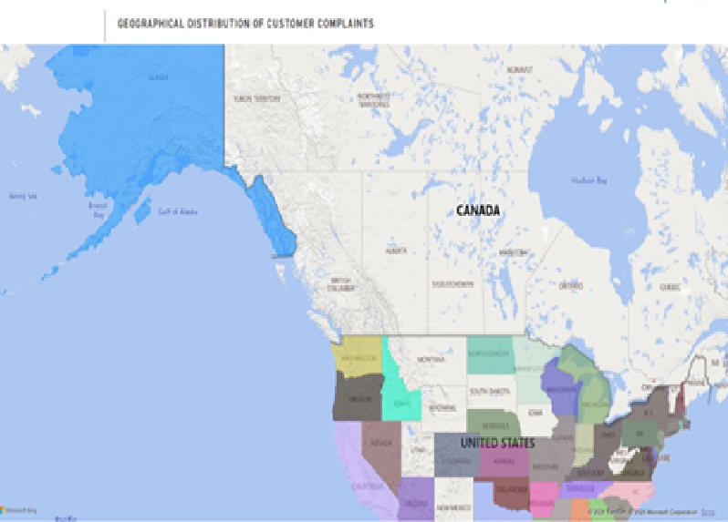
2. Which states and regions are hotspots?
Geographical Distribution of Customer Complaints
Complaints are concentrated in California, Texas, Florida, and New York, showing them as key hotspots.
These states represent the largest financial markets and population centers, driving higher complaint volumes.
Western states (CA, AZ, NV) show consistent consumer activity, likely tied to mortgage and credit issues.
Southern states (TX, FL, GA) record many cases linked to debt collection and banking services.
Midwestern and Northern states have lower complaint counts, reflecting smaller populations and fewer financial hubs.
Overall, high-complaint regions align with dense urban economies and diverse financial product usage.

Slide 6
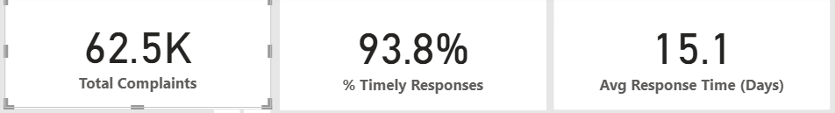
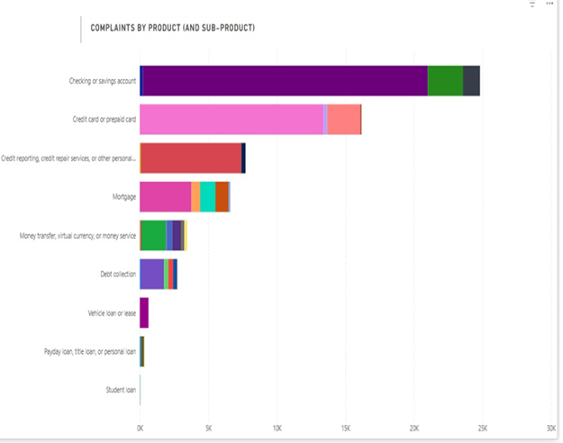
3. Which products and sub-products drive the most complaints?
Complaints by Product (and Sub-Product)
The dataset recorded 62,516 total complaints, with 93.8% receiving timely responses and an average response time of 15.1 days.
Checking or savings accounts generated the highest number of complaints, signaling major customer dissatisfaction with bank account management.
Credit card and prepaid card issues ranked second, reflecting ongoing disputes over billing, charges, and fraud.
Credit reporting and repair services followed, indicating persistent consumer challenges with inaccurate credit data.
Mortgages and money transfer services showed moderate complaint levels tied to payment delays and transaction errors.
Debt collection and vehicle loans had fewer cases, while student and payday loans recorded the lowest volumes.
Overall, deposit and credit card products are the main drivers of consumer complaints.

Slide 7
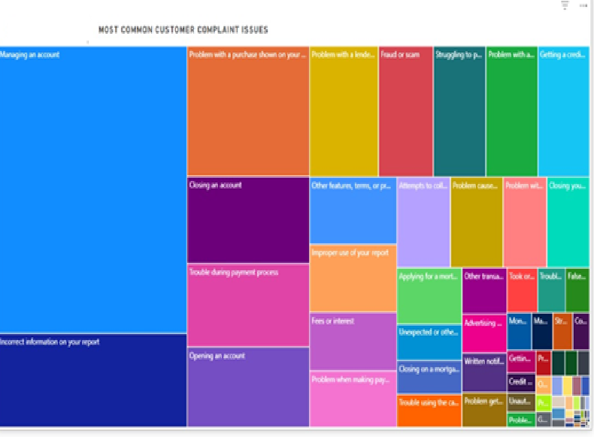
4. Which issues and sub-issues are most common or most severe?
Most Common Customer Complaint Issues
The leading issue is “Managing an account,” showing widespread problems with access, maintenance, and service delivery.
Incorrect information on credit reports ranks second, indicating persistent data accuracy and reporting errors.
Other major issues include problems with purchases, lender disputes, and fraud or scam cases.
Account closures, payment troubles, and fees or interest concerns also appear frequently, pointing to service transparency gaps.
Smaller but notable issues involve mortgage applications, unauthorized transactions, and collection attempts.
Overall, complaints center on account management, data integrity, and financial service reliability.

Slide 8
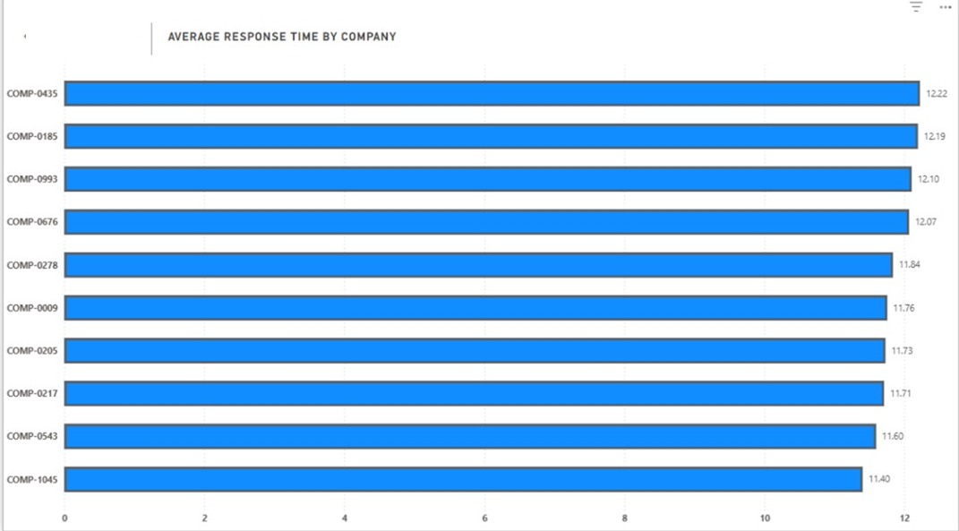
5. How fast, and how timely are company responses to complaints?
Average Response Time by Company
The top 10 companies have average response times ranging from 11.4 to 12.2 days.
COMP-1045 is the fastest among the group, with an average response time of 11.40 days.
The difference between the fastest and slowest companies is small (less than 1 day), suggesting a consistent industry-wide response performance.
Overall, financial companies respond to consumer complaints in about 12 days on average, which is reasonably timely given regulatory expectations.
The narrow gap between firms implies standardized complaint-handling processes across institutions, likely due to CFPB oversight and compliance requirements.
Focus on reducing response time below 10 days to exceed the industry average and improve customer trust.

Slide 9
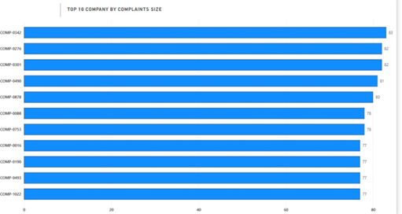
6. Which companies show the highest complaint rates relative to market share?
Top 10 Companies by Complaint Size
COMP-0342, COMP-0276, and COMP-0301 recorded the highest complaint volumes, each exceeding 80 cases.
These firms lead in complaint count, suggesting larger customer bases or recurring service issues.
COMP-0490 and COMP-0878 followed closely, both registering over 78 complaints.
The consistent scores across the top 10 firms indicate widespread industry challenges, not isolated cases.
High complaint volumes relative to peers imply possible quality control or communication gaps.
These companies should be prioritized for deeper compliance and customer service reviews.

Slide 10
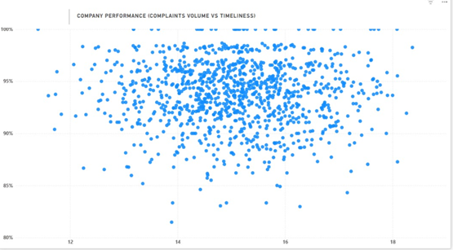
7. Do company traits (size tier, reputation, enforcement history) correlate with outcomes?
Company Performance (Complaint Volume vs Timeliness)
The scatter plot shows no strong linear relationship between complaint volume and response timeliness.
Larger firms with higher complaint volumes generally maintain response rates above 90%, reflecting structured customer service systems.
Smaller or mid-tier companies show more variation, with some delays and lower timeliness percentages.
Firms with consistent response times around 14–16 days perform best in both scale and service quality.
Reputation and compliance history appear linked to steadier outcomes and fewer late responses.
Overall, organizational maturity and process efficiency drive better complaint handling outcomes.
.

Slide 11
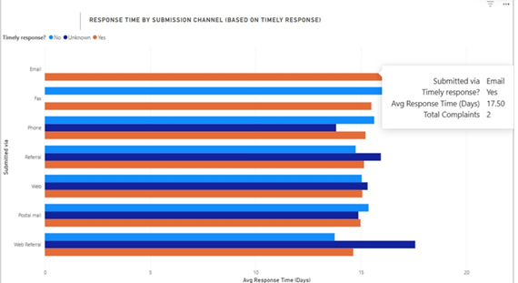
8. Do submission channels differ in response speed or outcomes?
Response Time by Submission Channel
Email and web submissions show the fastest response times, averaging around 17 days.
Phone and postal mail channels take slightly longer, often nearing 18–20 days on average.
Referrals and web referrals record more delayed responses, with a few exceeding 20 days.
Channels with digital submission paths (email, web) achieve higher timeliness rates and faster resolutions.
Traditional methods (fax, mail) show lower efficiency due to processing lags.
Overall, digital complaint channels deliver quicker responses and more consistent outcomes.

Slide 12
Lessons Learnt
Complaint patterns reflect economic and regulatory events, especially during 2020–2023.
Data cleaning and categorization are crucial for accurate visualization.
Interactive dashboards improve stakeholder understanding of consumer protection gaps.
Digital submission channels enable faster and more transparent company responses.

Slide 13
Summary
The analysis revealed that checking accounts, credit cards, and credit reporting services are the top complaint sources.
California, Texas, Florida, and New York are complaint hotspots.
Most companies respond within 15 days, with 94% timeliness, showing good compliance.
However, recurring issues in account management and data accuracy highlight the need for enhanced consumer data rights, stronger oversight, and improved service transparency.

Slide 14
Recommendation: Strategic Insights for Regulators, Journalists, and Consumers
Rising complaint trends (2020–2023) show growing consumer dissatisfaction, signaling a need for tighter oversight of financial service delivery and faster complaint resolution mechanisms.
Checking and savings accounts, credit cards, and credit reporting services generate most complaints, highlighting weak points in data accuracy, account management, and fee transparency.
High-complaint states (CA, TX, FL, NY) indicate where regulators should focus regional audits and compliance reviews.
15-day average response time suggests industry-wide efficiency but leaves room to mandate stricter response deadlines for urgent cases.
Firms with high complaint volumes but consistent timeliness show operational maturity, while outliers require targeted enforcement or corrective plans.
Digital submission channels outperform traditional ones, suggesting regulators promote online complaint platforms for speed and accountability.
Journalists can use these insights to spotlight systemic issues in account management and credit reporting, empowering consumers to make informed financial choices.
Transparency dashboards comparing company performance could pressure institutions to improve fairness and responsiveness.

Slide 15
Thank you

